Slide 1
Your School Can Celebrate Music in Our Schools Month!
Band
Orchestra
Guitar
Recorder
Mariachi
Chorus
&
Other Groups

Slide 2
The following slides will guide you and your school as you develop your own MARCH is MUSIC in OUR SCHOOLS MONTH festivities

Slide 3
NAfME and MIOSM
Share Your Story:
NAfME has over 300 stories so far!
MIOSM 2013 wants to collect and share over 1,000 stories.
Teachers, students, parents, administrators, public figures
How to Share:
Email shareyourstory@nafme2.org or DebraK.Lindsay@fcps.edu at VMEA to share your story in a future article in VMEA Notes.
Log on to Groundswell and post directly on the blog at http://advocacy.nafme.org/about/

Slide 4
NAfME and MIOSM
General Growth Properties Partnership
Virginia Schools (Crestwood Elementary School with the Lee High School Madrigal Singers, Manassas City Public Schools and other Virginia schools will be joining in the Concert in our Schools celebration -- see the recordings here: http://musiced.nafme.org/concert/videos/the-star-spangled-banner/), North Carolina, Kentucky, Indiana, Michigan, and Wisconsin will be featured in the 2013 concert.

Slide 5
NAfME and MIOSM
Public Service Announcements from major recording stars
Download at http://musiced.nafme.org/resources/why-music-psas-for-miosm-2013/

Slide 6
NAfME and MIOSM
Fact-a-Day
NAfME will post one fact about music education every day on social media during MIOSM
Twitter - @nafme
Facebook – facebook.com/nafme
Follow along with your music or general ed classroom
Publicize at the events at your school

Slide 7
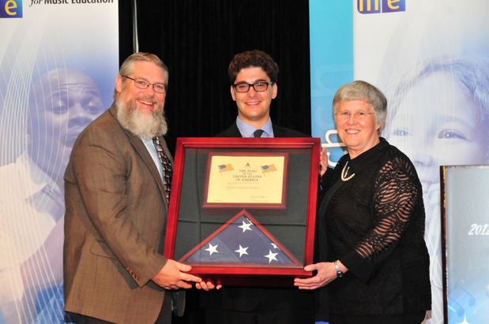
NAfME and MIOSM
Flag Contest
New rules for 2013
Register for flag certificate at nafme.org

Slide 8
The Concert for Music In Our Schools Month
Formerly known as “The World’s Largest Concert”, The Concert for Music In Our Schools Month is a music performance and advocacy activity which draws the attention of school administrators, local leaders and the community to school music programs.
Over the 27 years of its existence, over 6 million students, teachers, and supporters of music have participated in this highlight of Music In Our Schools Month.

Slide 9
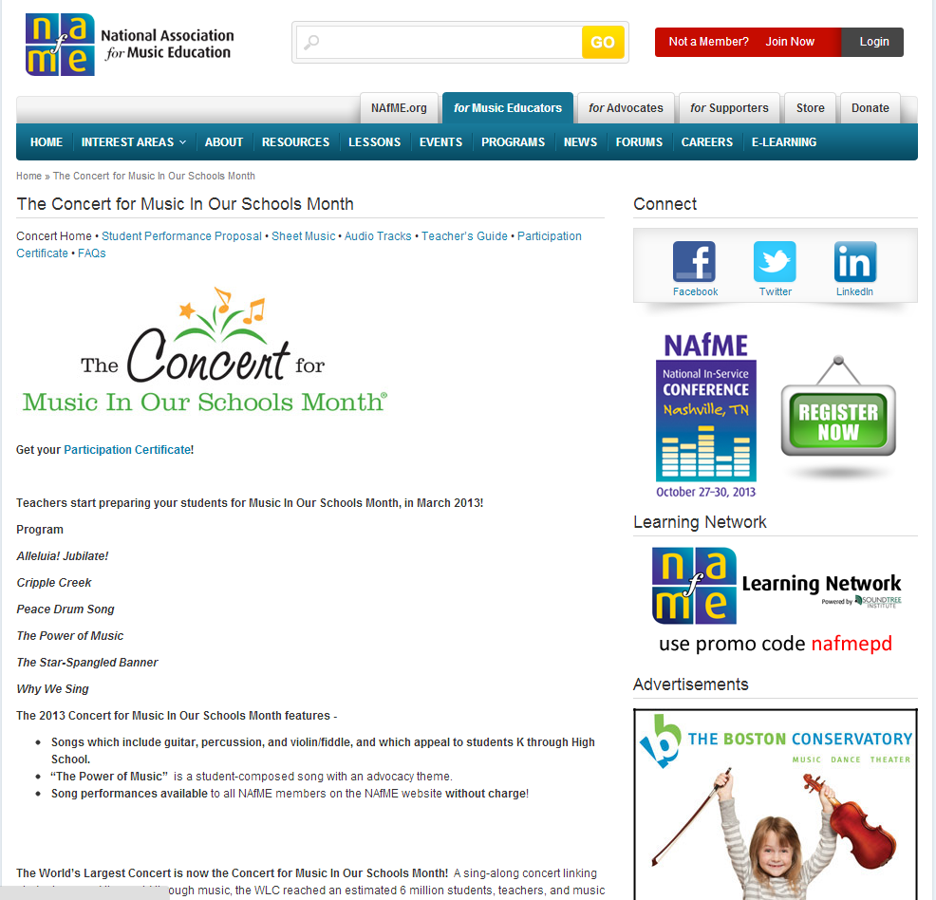

Slide 10
Participate in the March Concert
Teach any number of the concert songs and lessons. The free sheet music, performance tracks, and lesson plans are provided by Hal Leonard and NAfME, and are on the Concert webpage at http://musiced.nafme.org/concert/
Sing any number of the concert songs in the classroom, in a school concert, in a school or community performance at any time during March, Music In Our Schools Month®

Slide 11
Participate in the March Concert
View and sing along with the Concert for Music In Our Schools Month online performances in the classroom, school, or community anytime during March, with a full concert performance, a school sing-along, or as a community advocacy activity.
Invite your local school and civic leaders to join your celebration.
Tell us how your school participated in the Concert, and receive your official Concert Participation Certificate on the Concert homepage. http://musiced.nafme.org//concert

Slide 12
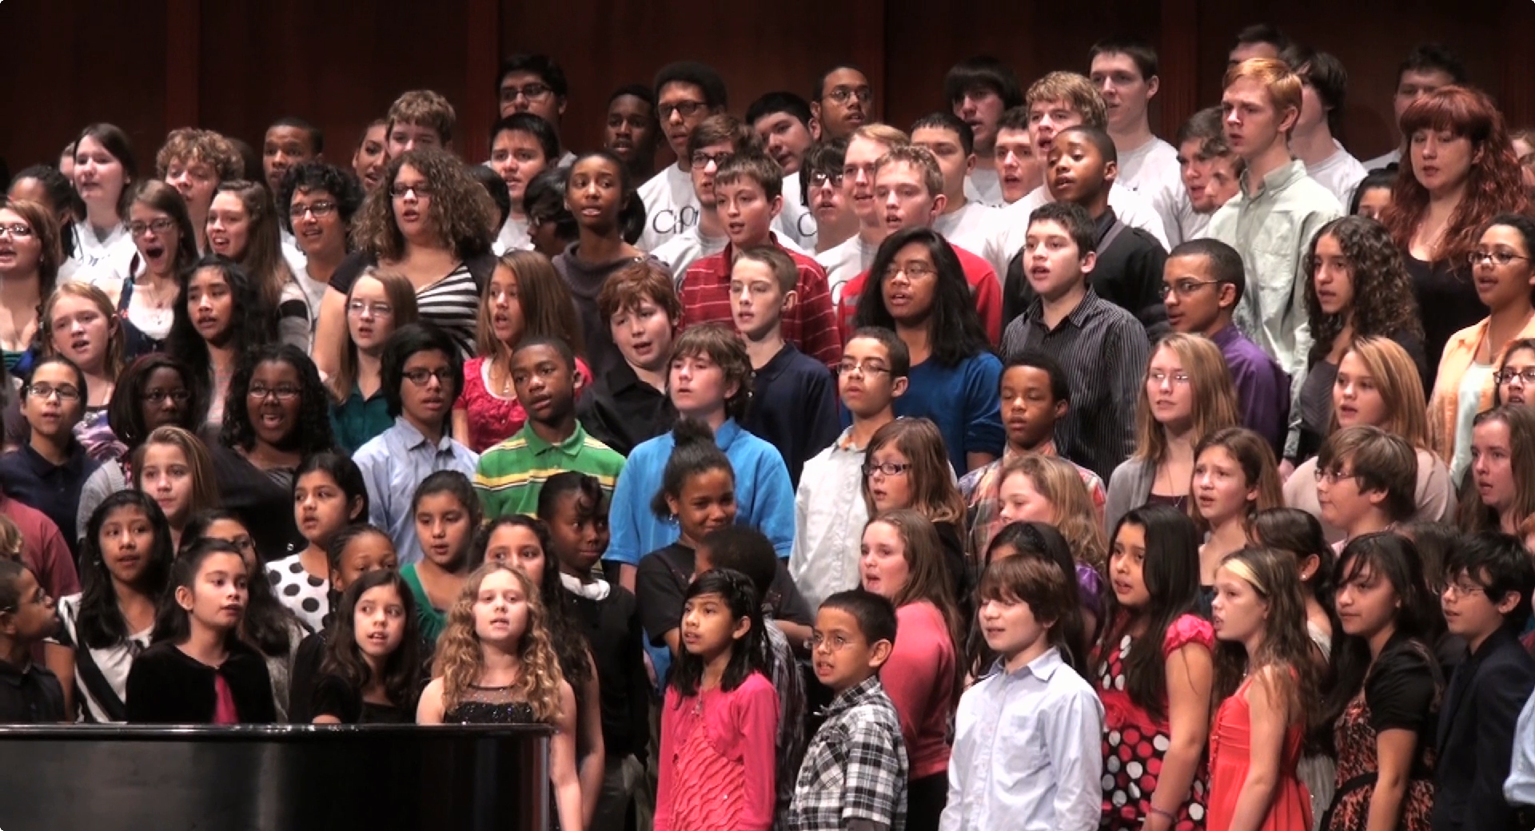
The Concert for Music In Our Schools Month

Slide 13
Virginia and MIOSM: More Ideas
Public Performances
Arrange your own public performance and tell us about it (DebraK.Lindsay@fcps.edu)
Marketing managers at shopping malls
Local sporting events
Community outreach and education

Slide 14
Virginia and MIOSM: More Ideas
Local and State Legislators
Performances at Public offices: Capitol building, city hall
Invite VIPs for classroom visits
Visit advocacy.nafme.org for tips on contacting stakeholders
Remember that publicity is your friend. Be bold and have fun!

Slide 15
Virginia and MIOSM: More Ideas
Fundraising
MIOSM is a great month for fundraisers.
or
Ask for donations or pledges in place of fundraisers.

Slide 16
Visit the NAfME Website
Find activity Ideas: http://musiced.nafme.org/events/music-in-our-schools-month/miosm-activity-ideas
Find tips for working with the media to raise awareness
Register for the Flag Certificate
Share Your Story

Slide 17
Final Reminders
Tell us what you’re doing
Blogs, forums, social media
Email us with questions

Slide 18
Thank you for your effort to support music education in Virginia schools.

Slide 19
http://musiced.nafme.org
and
(Remember to share you photos and articles with DebraK.Lindsay@fcps.edu
for inclusion in the fall edition of VMEA Notes.)

